Slide 1




UX/UI DESIGNING

Slide 2
Project Name
Garage Application Design

Slide 3

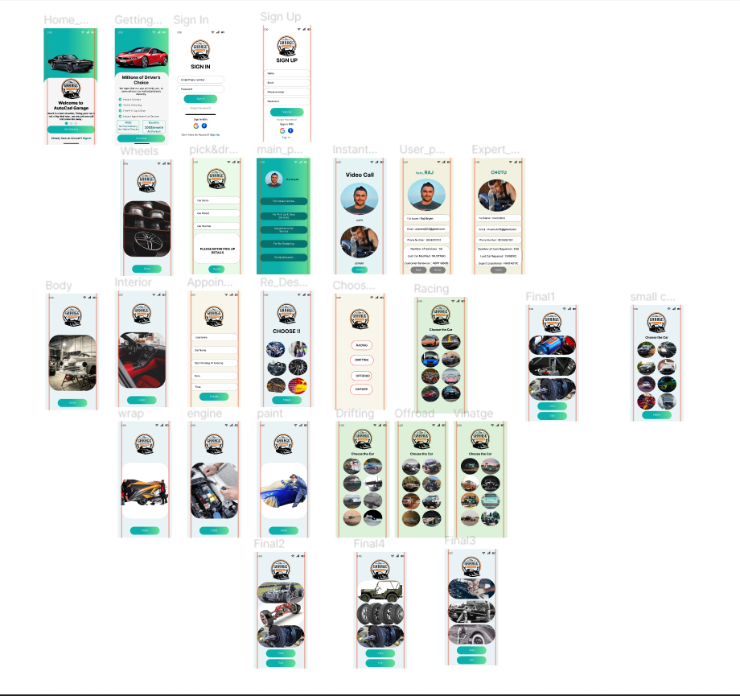

FRAMES

Slide 4
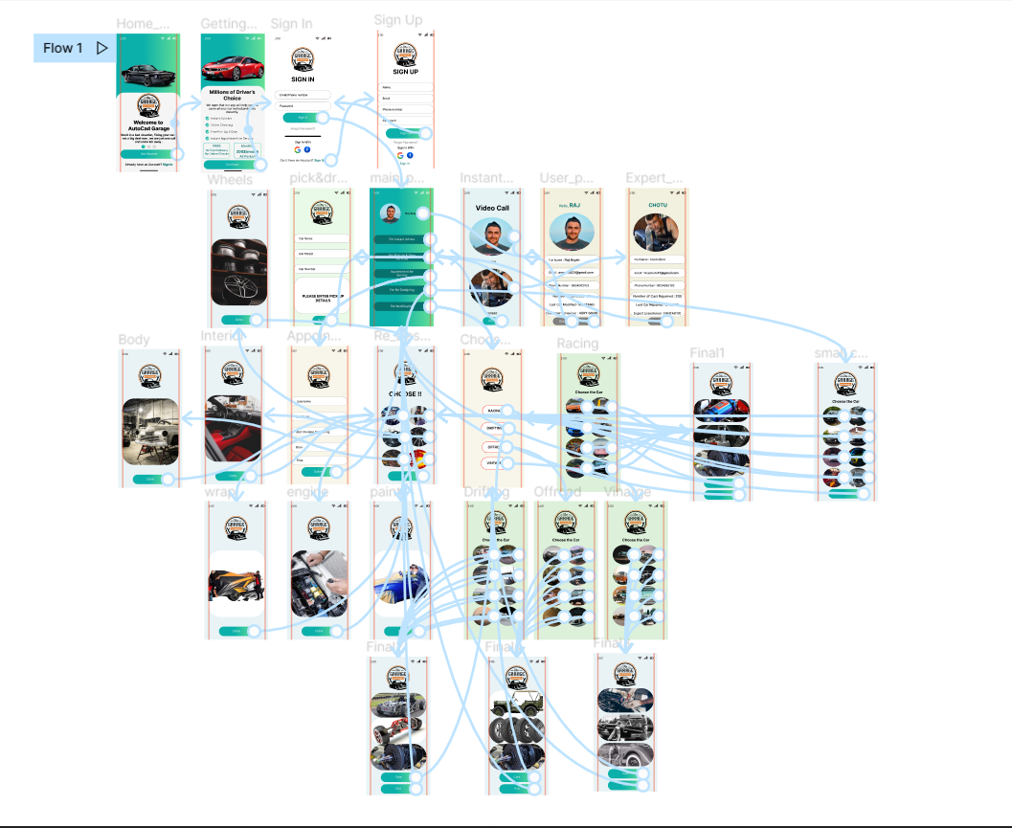
CONNECTIONS

Slide 5
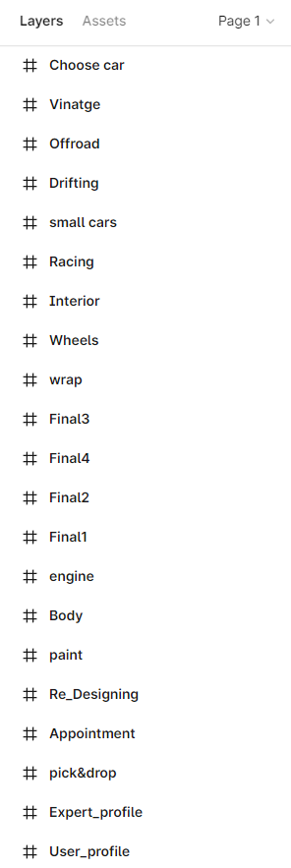
FRAME NAME

Slide 6
LINK OF PROJECT
https://www.figma.com/file/UmMwpqziZt1GbiZ9q8hbf4/Garage_App?node-id=0%3A1

